Slide 1
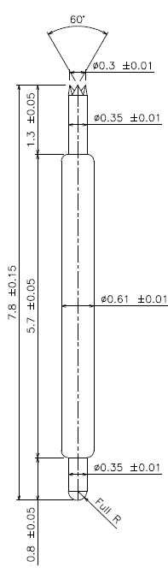
※ POGO type – 7.8mm / 0.8P
IVB-DRA-780-061-A139-00
Pitch | 0.8mm
Total Length | 7.8mm
Use Length | 7.0mm
Recommended Stroke | 0.8mm
Max Stroke | 1.3mm
Spring Force at Use Stroke | 30gf at 0.8mm Stroke
Operating Temperature | -40 to 125°C
DC Resistance | Avg. mΩ at 0.8mm stroke
Current Rating | 2.0A
Self Inductance | 2.5 nH
Bandwidth @ -1dB | 15.2 GHz
Top Plunger | BeCu / Au over Ni
Bottom Plunger | BeCu / Au over Ni
Barrel | Phosphor bronze / Au over Ni
Spring | Music Wire / Au over Ni
Insertion Life | 100,000 cycles at 0.8mm Stroke

